Slide 1
Student Portal
Providing Students with Study Resources and Interaction with Seniors

Slide 2

Introduction
The goal of the student portal is to give students a centralised location where they can obtain study materials, interact with classmates and lecturers, and maintain organisation.
To help students learn, the website will offer a variety of study resources, including study materials, and Past Papers.
In order to enhance the learning process, links to external study resources will also be supplied.
Photo by Pexels

Slide 3

Past Papers
Students have the chance to practice responding to questions that are similar to those on exams by using past papers.
Students can familiarise themselves with the format and structure of the exams they will be taking by completing prior papers.
Previous exams provide students the chance to get insight into how they performed. Reviewing completed papers allows teachers or tutors to point out areas for student growth
Photo by Pexels

Slide 4

Study Resources
Study resources in a student portal provide support for learning, easy accessibility, increased efficiency, personalized materials, and exam preparation. These resources are essential for students to achieve academic success by providing additional information and tailored recommendations for individual needs.
In general, a student portal must provide study resources. A student portal can help students learn and succeed by giving them access to a variety of materials. It can also be a useful tool for them to reach their academic objectives.
Photo by Pexels

Slide 5
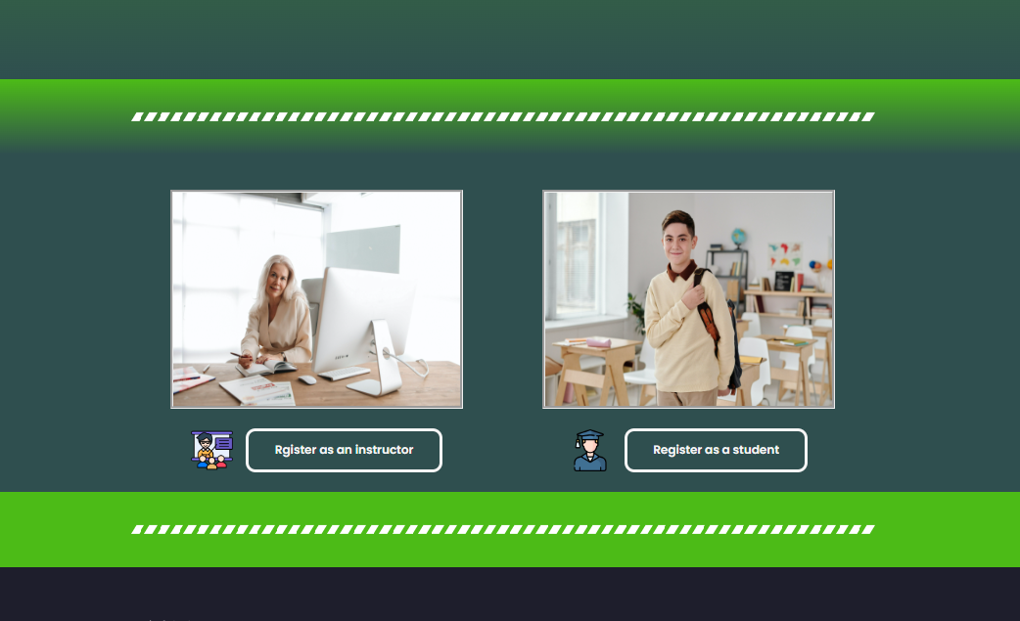
User Interface
Photo by Pexels

Slide 6
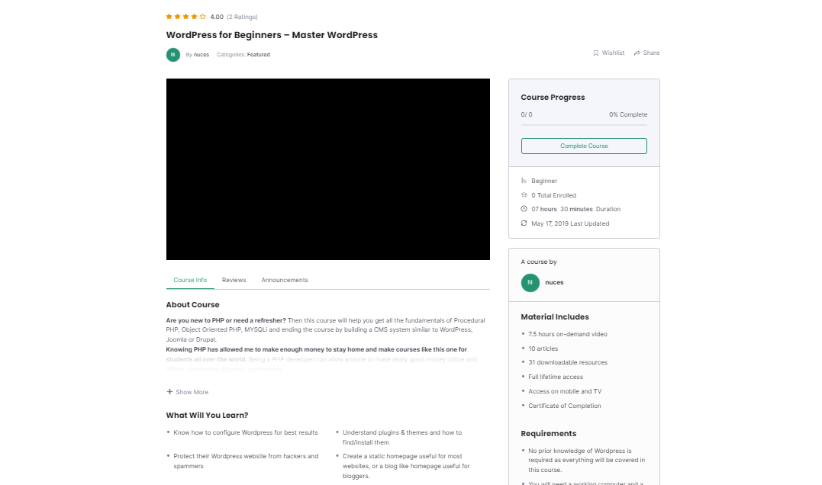

Slide 7
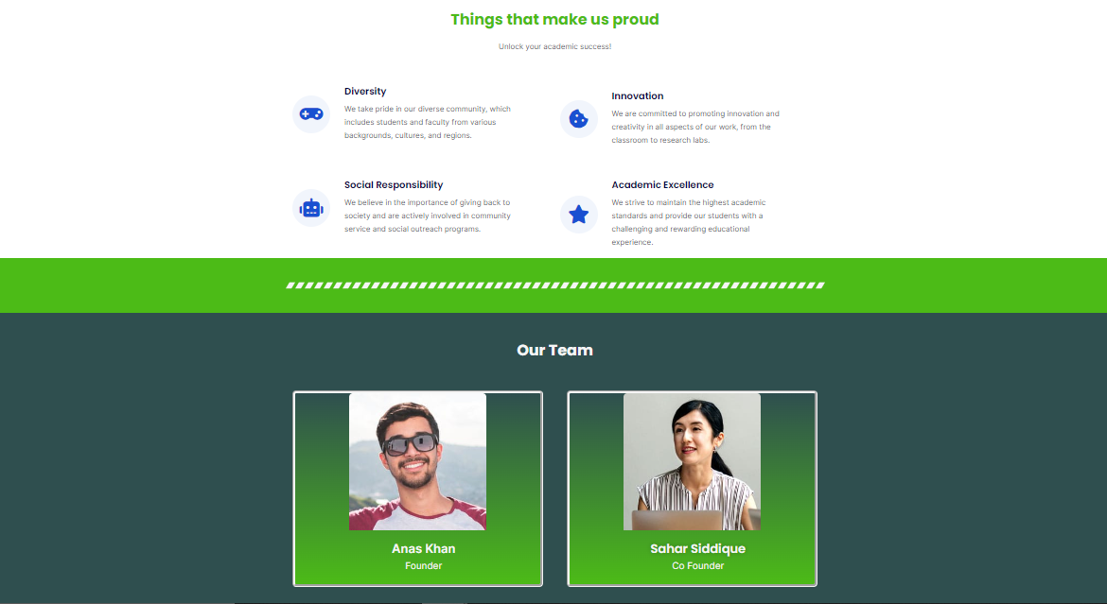

Slide 8
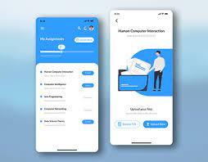
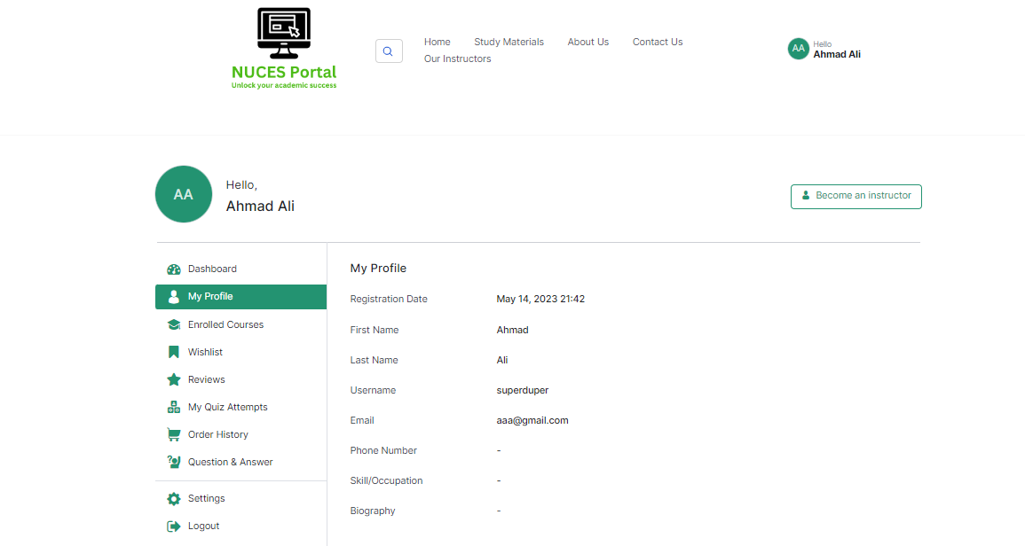
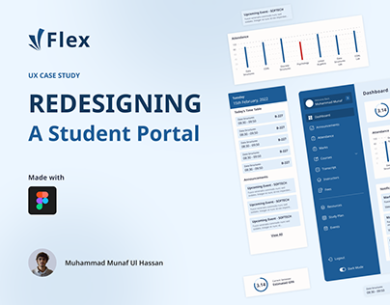
User Interface
Photo by Pexels

Slide 9
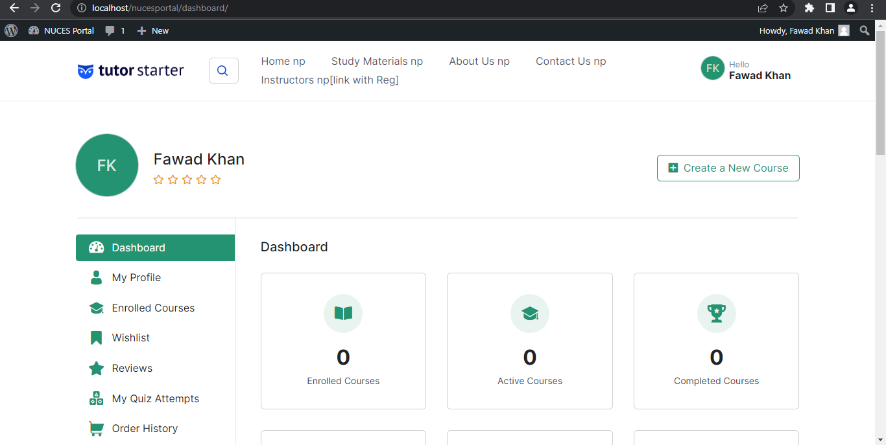

Slide 10

Conclusion
In conclusion, NUCES Portal is a comprehensive education platform that aims to make learning more accessible and convenient for students. By providing a user-friendly interface, a wide range of study resources, and opportunities for collaboration, we are confident that NUCES Portal will prove to be an indispensable tool for learners at every stage of their academic journey. We look forward to continuing to improve and expand our platform in the future.
Photo by Pexels

